Slide 1
The Power of Pivot Tables
Elliot Orenstein
06/21/2022

Slide 2
Review
Last time, we learned about:
Cleaning and formatting data in Excel
Calculating summary statistics (sum, average, count)

Slide 3


Introduction
Picture this. It’s time to evaluate last quarter’s sales performance. You open the spreadsheet and find a table with 10,000 rows and 20 columns of data, with each row representing an individual sale.
Q: How can you get a clear, high-level picture of your company’s performance quickly and without messy formulas?
A: Pivot Tables!

Slide 4
Agenda
1
Define Pivot Tables and explain why they’re useful
2
Prepare data for Pivot Tables
3
Create Pivot Tables in Excel
4
Learn about advanced features

Slide 5
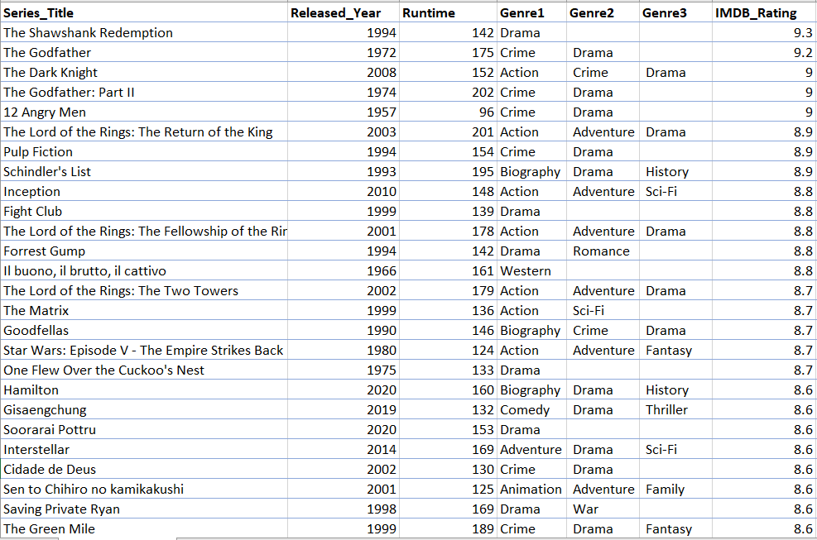

Pivot Tables are aggregated tables
Pivot Tables are customizable tables in Excel that aggregate (AKA “group”) data by fields from a larger dataset. They help users better understand, analyze, and summarize their data.
Source Data
Pivot Table

Slide 6


Pivot Table use cases
A PivotTable may be useful when you need to:
Filter
Sort
Sum
Average
Count
Max, min
Can’t we perform all these tasks in our original dataset?
Yes, but Pivot Tables allow us to aggregate by categories and are quick and flexible!

Slide 7
Activity
Determine what the columns, rows, and values of the Pivot Table would be for the following examples (there’s not one right answer!)
1.
2.
Each row of your dataset represents a sale at your local bike shop chain. Columns of the dataset are:
shop location
date
day of the week
number of items purchased
amount purchased
Calculate the average number of items purchased in a sale by day of the week and by shop location.
*not real data

Slide 8
Preparation for Pivot Tables
Before we begin, let’s explore our source data. We should ask ourselves the following questions:
What does each row in the dataset represent?
Remember, our insights are only as good as our source data!
What columns does our dataset contain?
What format should the values of each column be?
Do I see any errors (misspellings, missing data, etc.)?

Slide 9
Two helpful tips before pivoting
Convert source data to an Excel table
Remove summary rows from source data
If you’ll be adding or removing rows (e.g., adding new purchases to your sales data), you’ll want to convert your source data to an Excel table.
With your source data in Excel table format, your Pivot Tables will automatically include changes to your data when you refresh.
To do this, choose any cell in your dataset. Click Ctrl + T. Done!
Tables may come with totals in the final row. Your Pivot Table may mistake this for a data point.
To avoid any confusion, remove any summary rows from your source data. If you want to see the totals, add that to your Pivot Table.

Slide 10
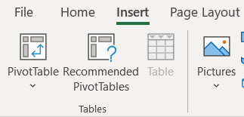
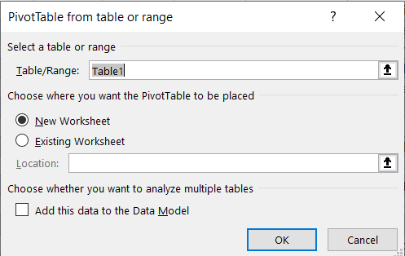
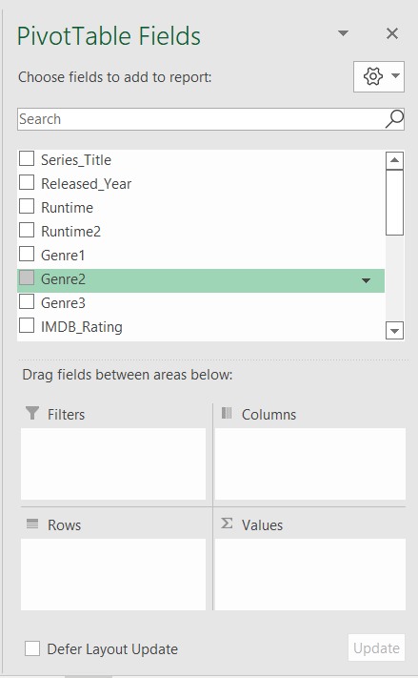
Creating a Pivot Table in Excel
1
2
3
Let’s look at the top 1,000 IMDb movies in an Excel spreadsheet!

Slide 11
Advanced features
Pivot Tables are powerful due to their high levels of customizability.
Aesthetics, formatting,
visualizing
Advanced grouping
Advanced filtering and sorting
Drill down
Alternative value calculations

Slide 12


Summary
Pivot Tables are a fundamental tool to summarize lots of data
Unlike a regular table, Pivot Tables aggregate by fields
Pivot Tables have many advanced features that allow data analysts to dig deeper into their data
Notes:
Briefly discuss

Slide 13
Post-lesson understanding check
List at least three reasons you may want to use a Pivot Table when analyzing large amounts of data.
What is the difference between Count and Sum values?
Which of the following can you NOT drag fields into when building Pivot Tables in Excel?
Filters
Totals
Columns
Rows
Values

